Slide 1

Resume Classification
Project DS_P580 Team:Group 2
Kaushik Sonnakula
Junthula Sai Charan
Kishan Senjaliya
Karlapudi Sasi Anuhya
Ms. Malavika.A.S
Suprit itagi
Sujey Dash

Slide 2
AGENDA
Introduction & Objective
Data Overview
Exploratory Data Analysis (EDA)
Model Building & Evaluation
Deployment (Streamlit App)
Results & Insights
Conclusion

Slide 3

Introduction & Objective
Aim: To build an automated system for classifying resumes into job categories.
Importance: Enhances hiring efficiency by saving time and reducing manual effort.
Objective: To apply NLP and ML for accurate and scalable resume classification.
Application: Used in recruitment, HR, job portals, and campus placements.

Slide 4
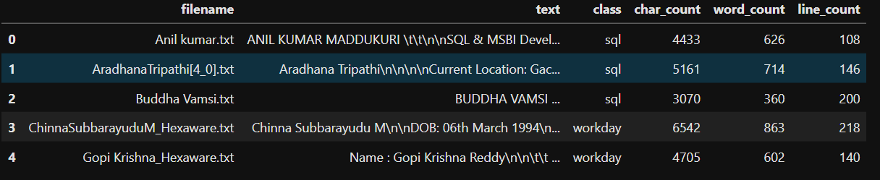
Data Overview
Records: ~79 resumes (sample dataset size).
Features:
Text – extracted resume content
Class – job category label (SQL, Workday, Internship, Peoplesoft, React JS)
Text statistics (word count, character count, line count).
Target: Resume job category (5 classes).
Clean dataset: No missing values after preprocessing, categorical labels, textual features extracted from resumes.

Slide 5
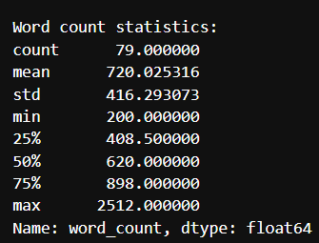
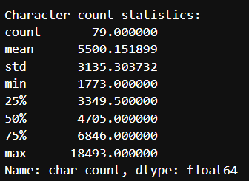
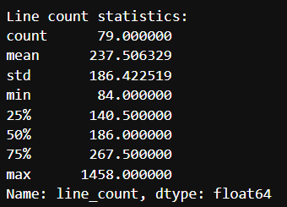
Text statistics:
Word Count Statistics
Mean (average): ~416 words per resume.
Minimum: 20 words → indicates very short resumes (possibly incomplete or internship-based).
Maximum: 2312 words → represents very detailed resumes.
Median (50%): Around 628 words, meaning most resumes fall in the 500–700 range.
Character Count Statistics
Mean: ~3776 characters per resume.
Range: From about 353 characters (short) to 18,830 characters (long).
25% Quartile (Q1): 1045 characters,75% Quartile (Q3): 6846 characters — showing moderate skewness toward longer resumes.
Line Count Statistics
Mean: ~237 lines per resume.
Minimum: 84 lines → concise resumes.
Maximum: 1458 lines → highly descriptive resumes (possibly formatted with bullet points).
Median: ~186 lines.

Slide 6
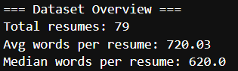
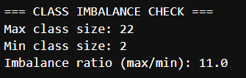
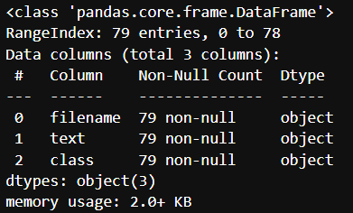
Exploratory Data Analysis (EDA)
Objective: Understand the structure, distribution, and patterns of the resume dataset before modeling.
Data Shape: 79 records, 3 columns – filename, text, class.
Data Types:
filename – Identifier
text – Resume content (unstructured textual data)
class – Categorical (job category label)

Slide 7
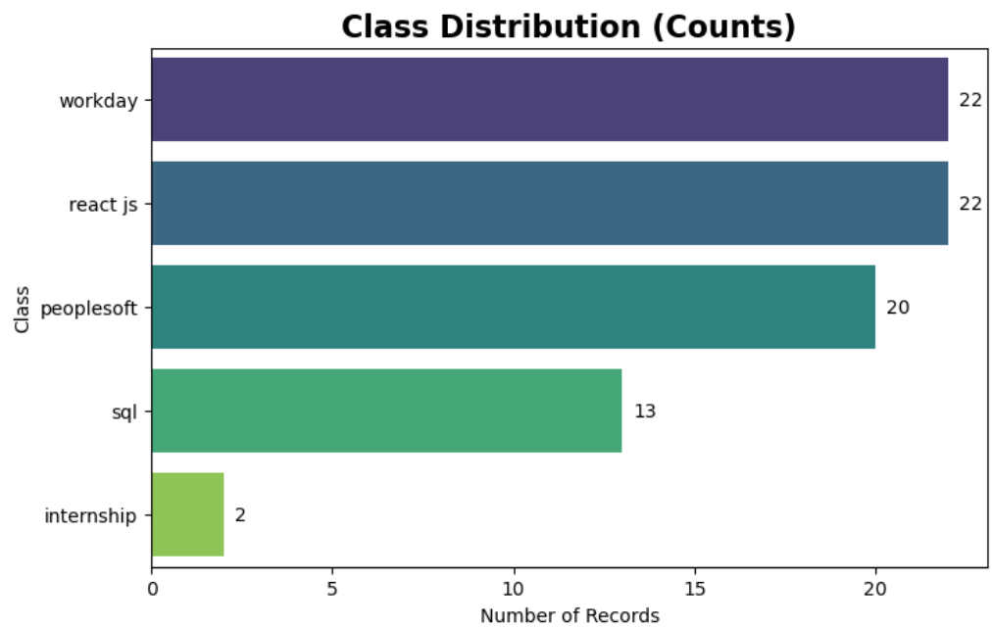
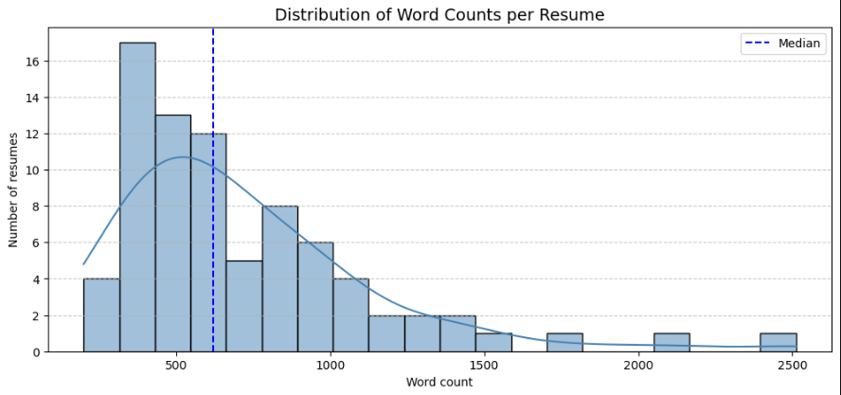
Target Distribution:
5 classes — SQL, Workday, Internship, Peoplesoft, React JS.
Slight class imbalance (Internship is smaller).

Slide 8
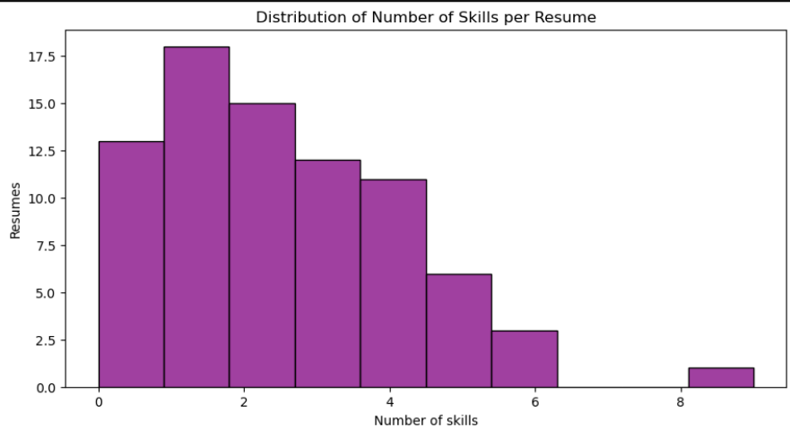

Slide 9
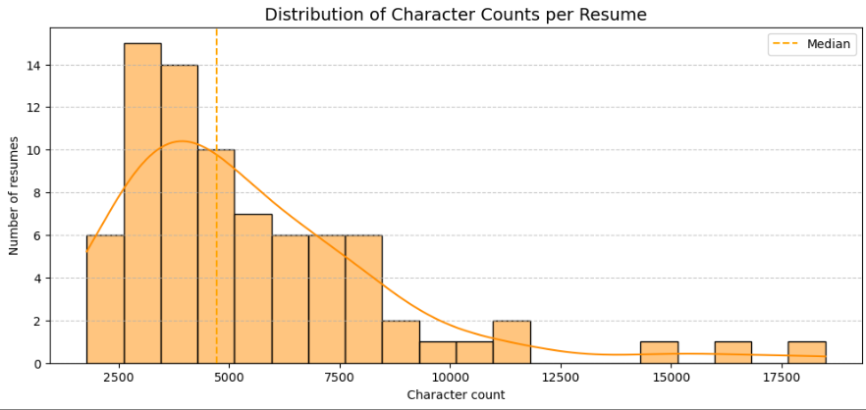
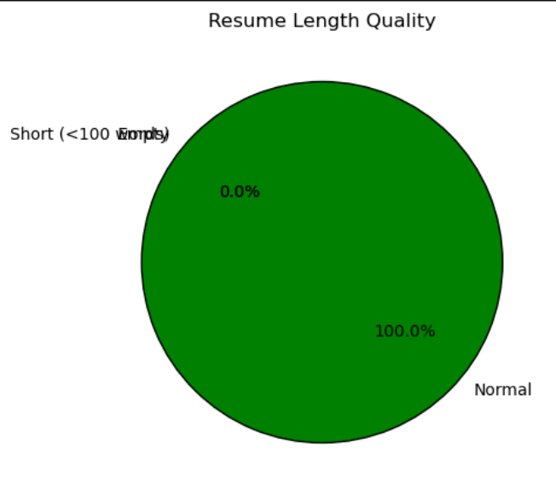
Resume Length Analysis:
Word count and character count analyzed for each resume.
Moderate variation in text length and vocabulary size

Slide 10
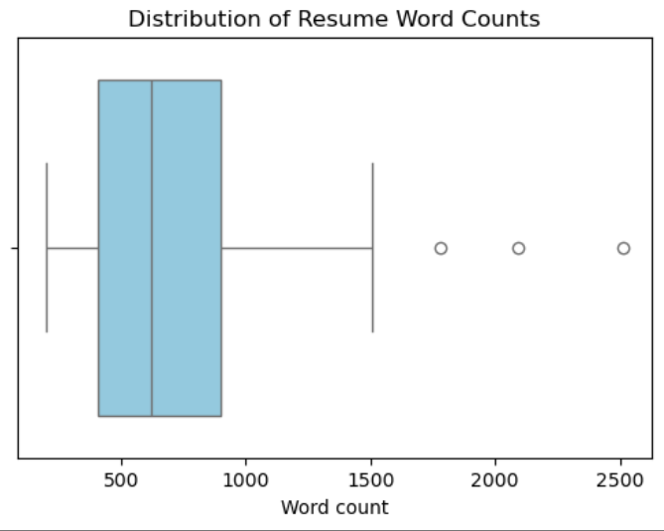
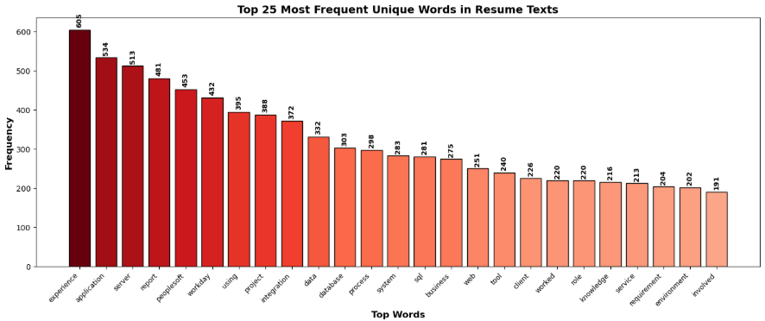

Slide 11
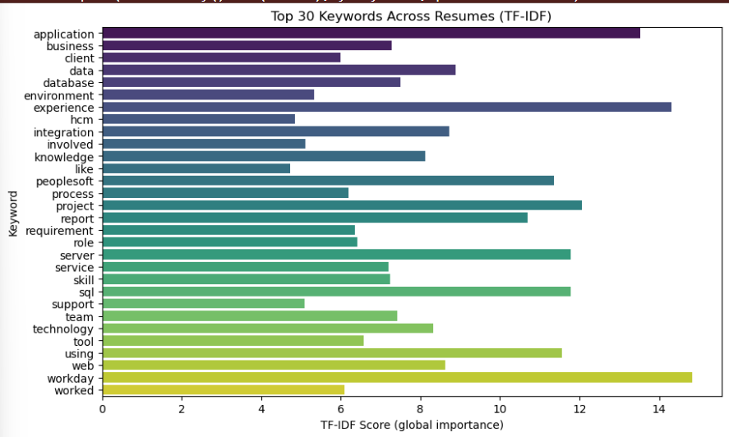
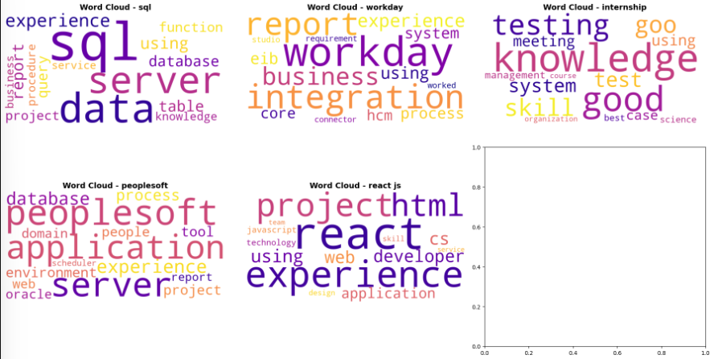
Keyword and Text Features:
Frequent terms identified with TF-IDF and WordClouds.
Stop words, punctuation, and numbers removed prior to analysis.

Slide 12
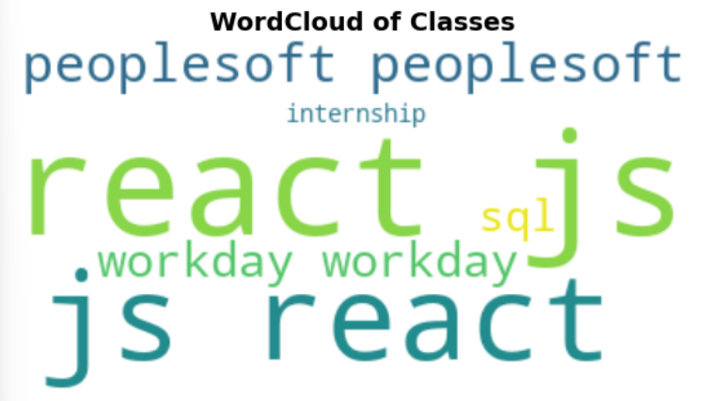
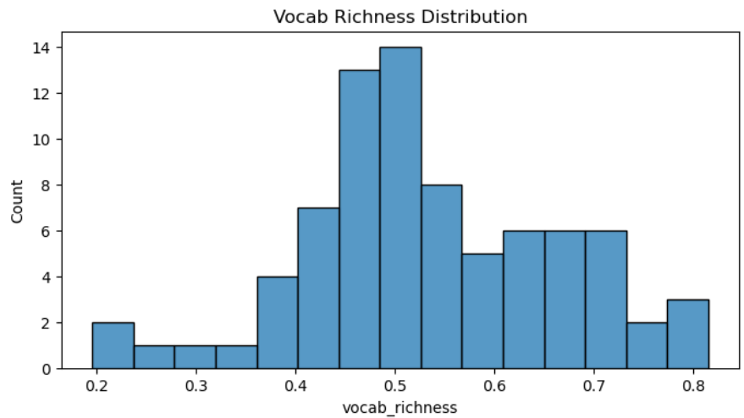

Slide 13
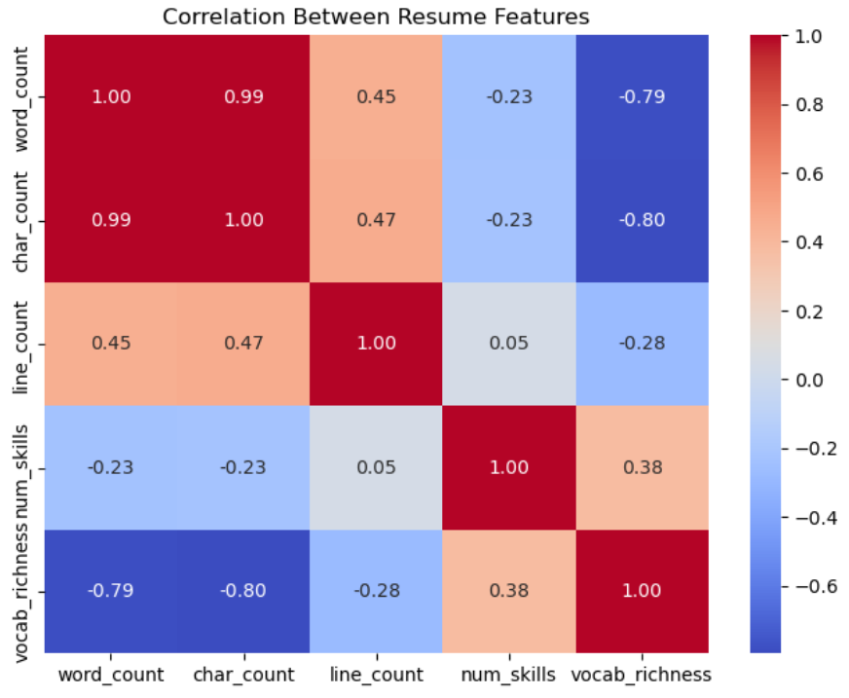
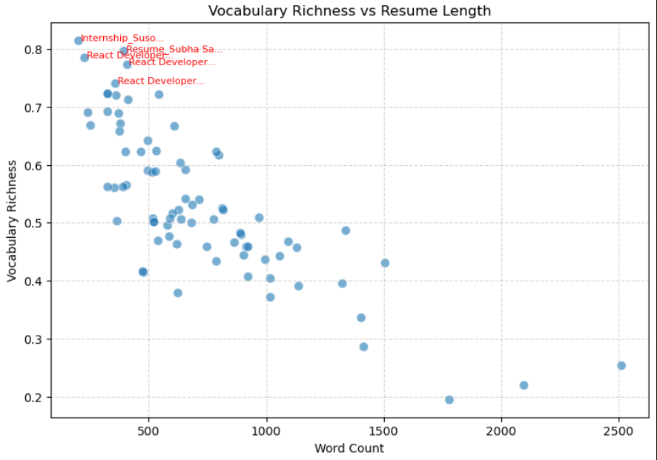
Correlation and Category Insights:
Keywords are strongly associated with specific classes (e.g., “hooks”, “frontend” → React JS).
Scatter plot: Vocabulary richness vs resume length.

Slide 14
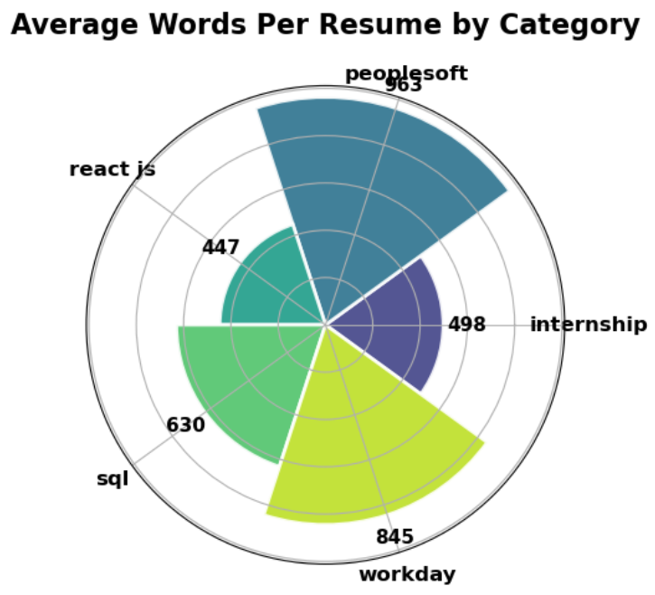
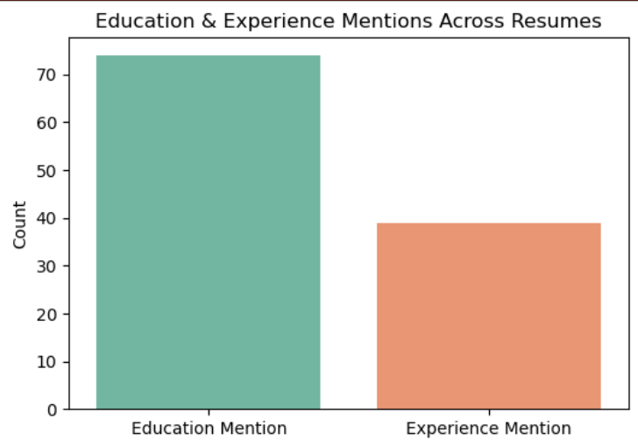

Slide 15
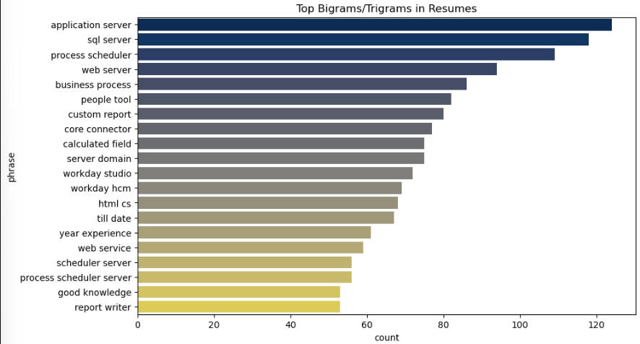
Summary of Findings:
Resume features vary with job class
Visuals provide clear distinction in text length, keyword focus, and best resume writing practices by specialization

Slide 16
Model Building & Evaluation
Preprocessing: Text cleaning → Tokenization, Stopword Removal, TF-IDF Vectorization.
Models Tested: Random Forest, XGBoost, LightGBM, Logistic Regression,Support Vector Machine, CatBoost,MLP (Dense Neural Network).
Evaluation Metric: Accuracy, Precision, Recall, F1-score.
Best Model: Selected based on highest F1-score across categories.
Deployment Ready: Final model saved as resume_model.pkl for integration.
Algorithms Used:
Random Forest
XGBoost
LightGBM
Logistic Regression
Support Vector Machine
CatBoost
MLP (Dense Neural Network)

Slide 17
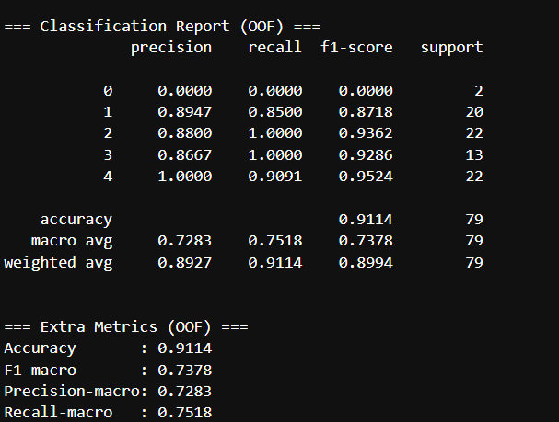
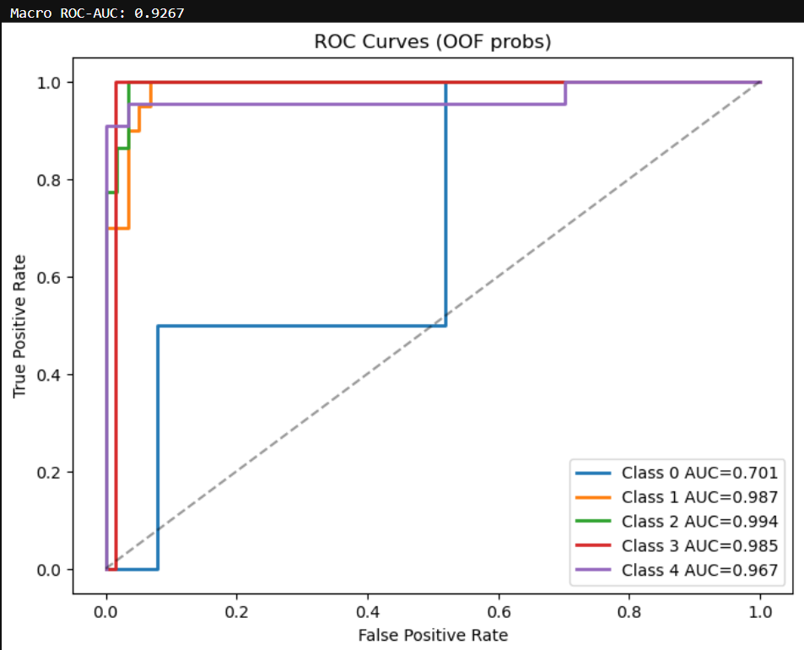
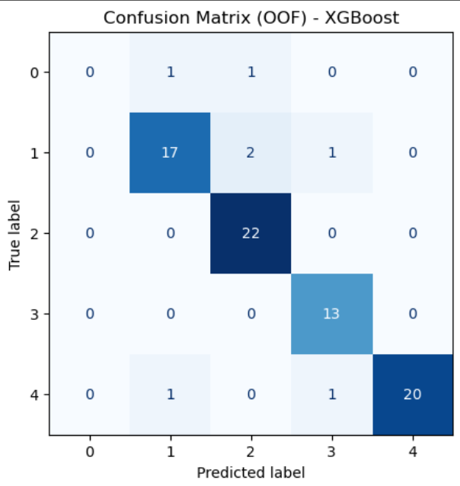
Model - XGBoost (class weights)

Slide 18
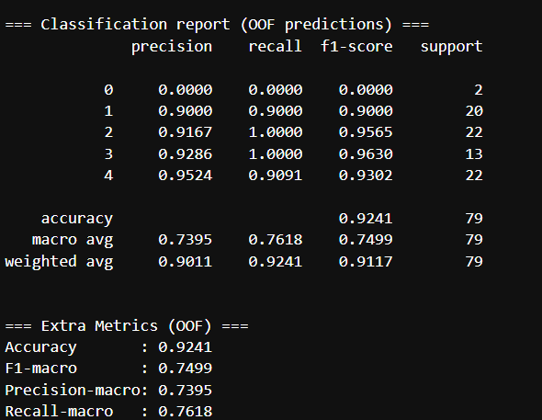
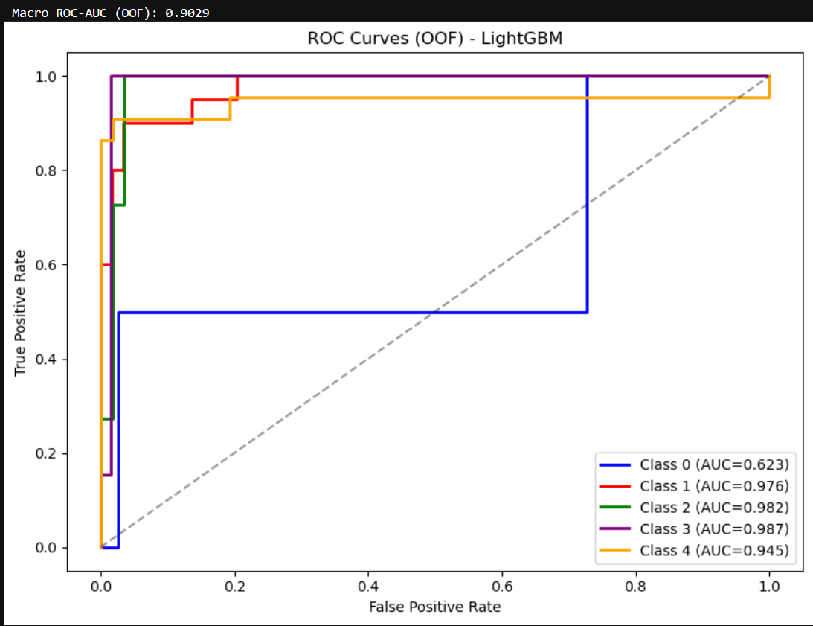
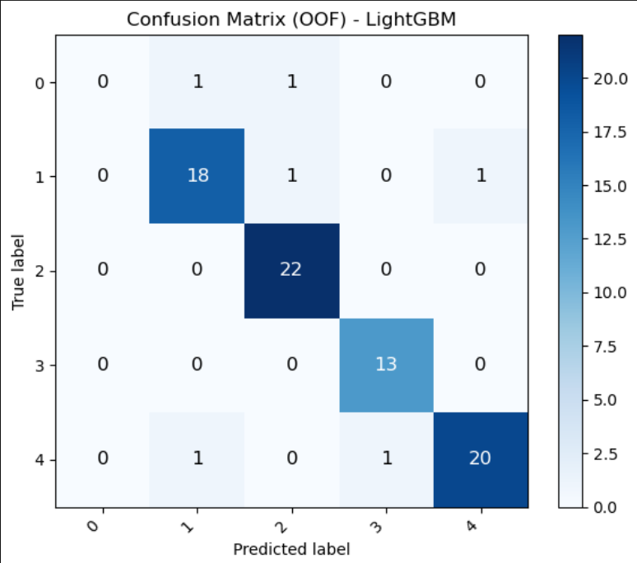
Model - LightGBM (class weights)

Slide 19
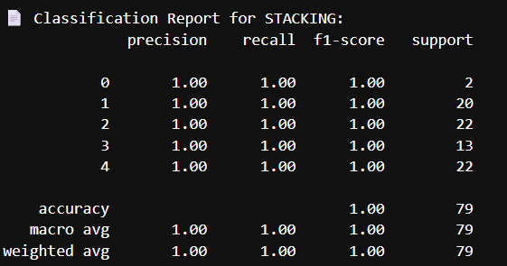
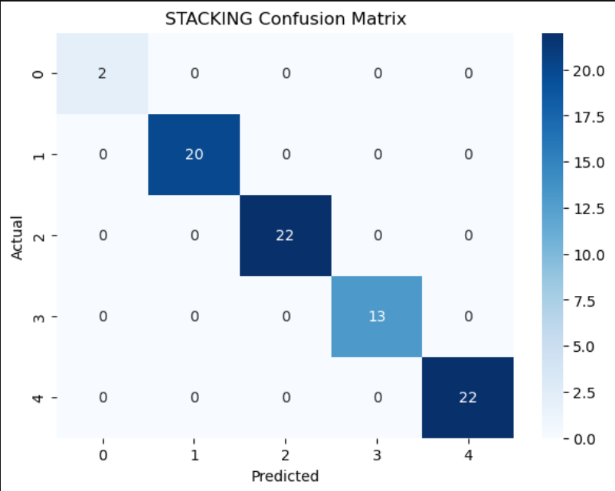
Stacking Ensemble

Slide 20
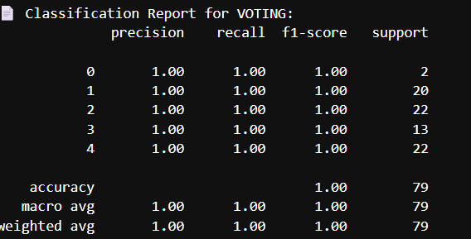
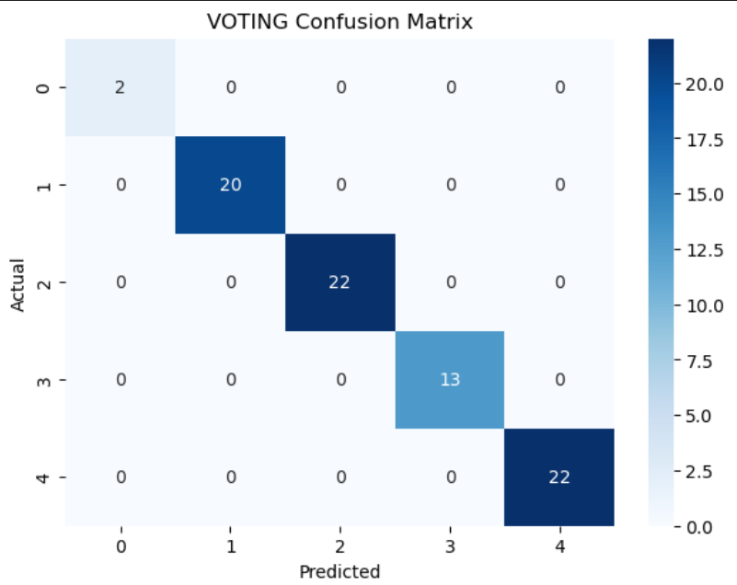
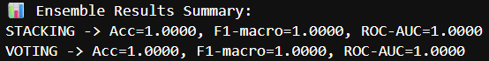
Weighted Voting Ensemble
Both Ensembles models results

Slide 21
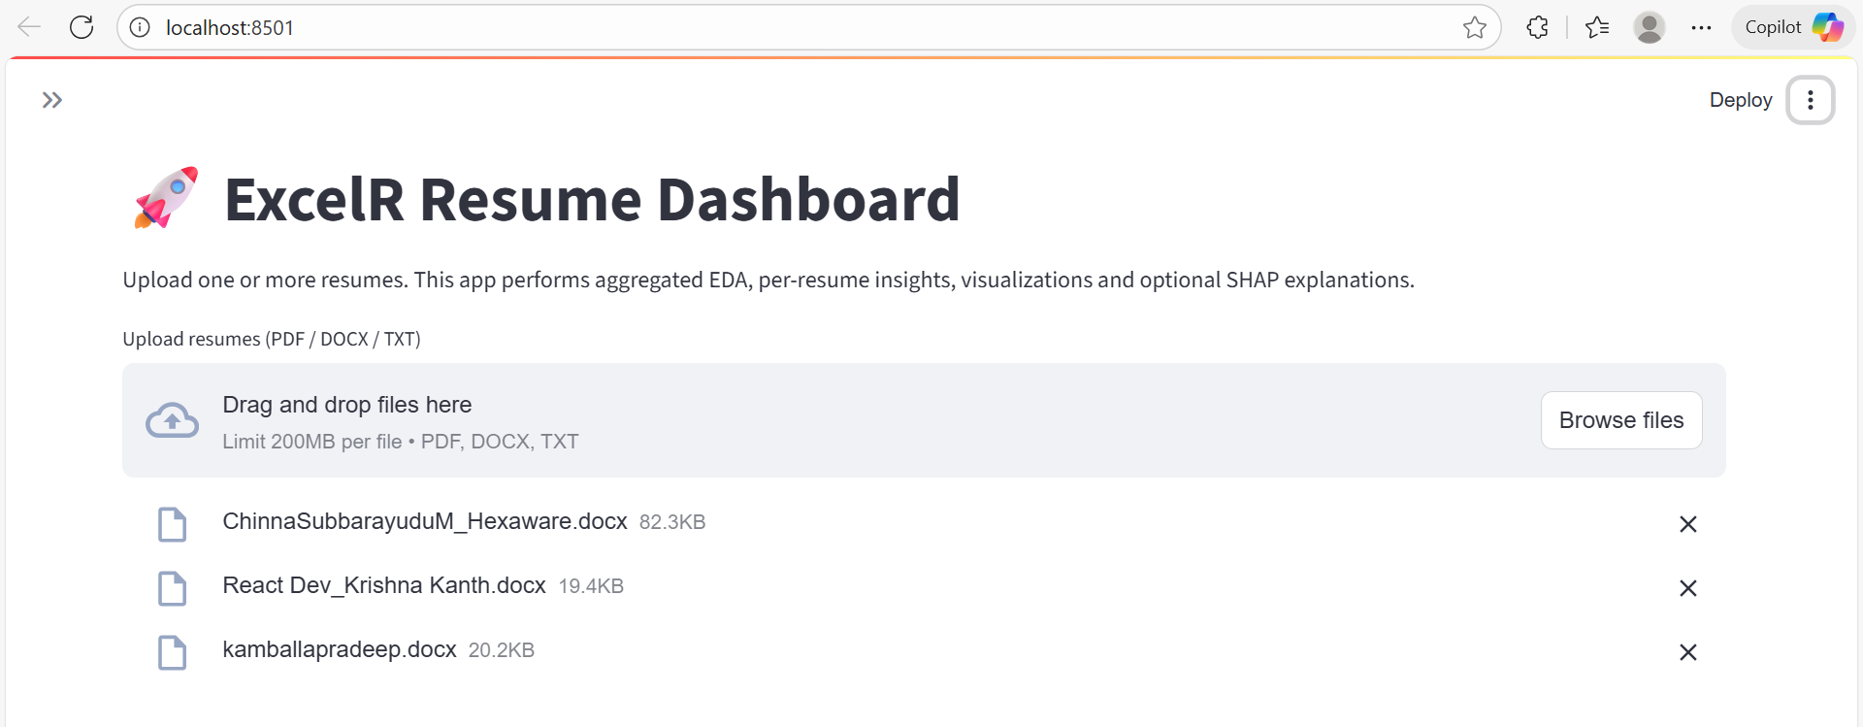
Deployment(Streamlit App)
Step 1: Upload Resumes
Users can upload multiple resumes in supported formats like PDF, DOCX, and TXT through an easy drag-and-drop interface.

Slide 22
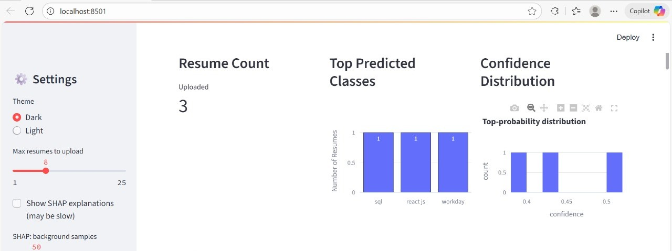
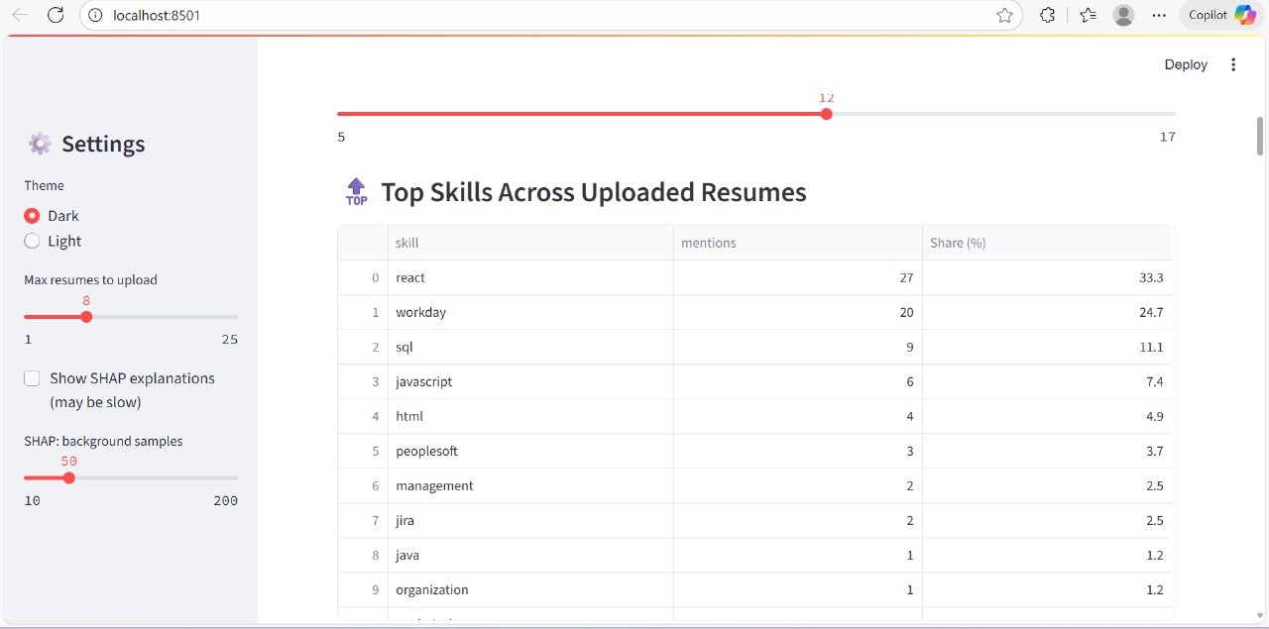
Step 2: Data Processing & EDA
The app extracts text from resumes and performs aggregated Exploratory Data Analysis (EDA), showing skill distributions, word clouds, and text length statistics

Slide 23
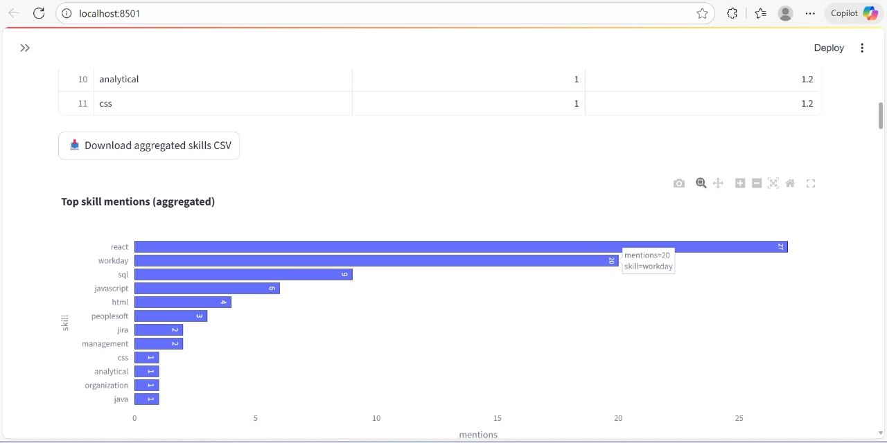
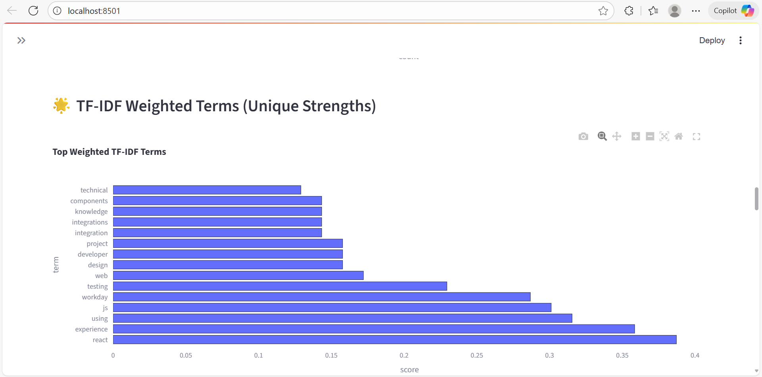

Slide 24
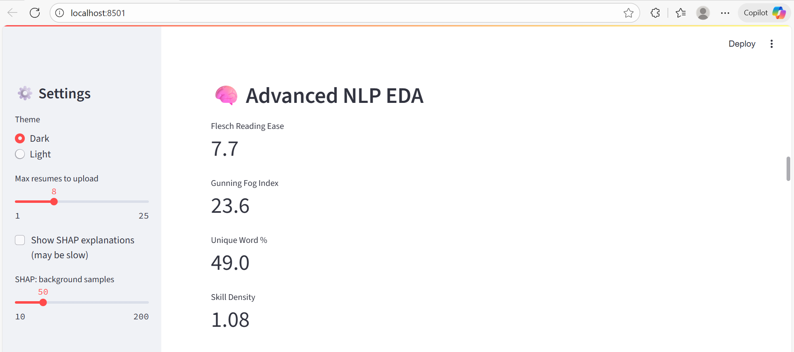
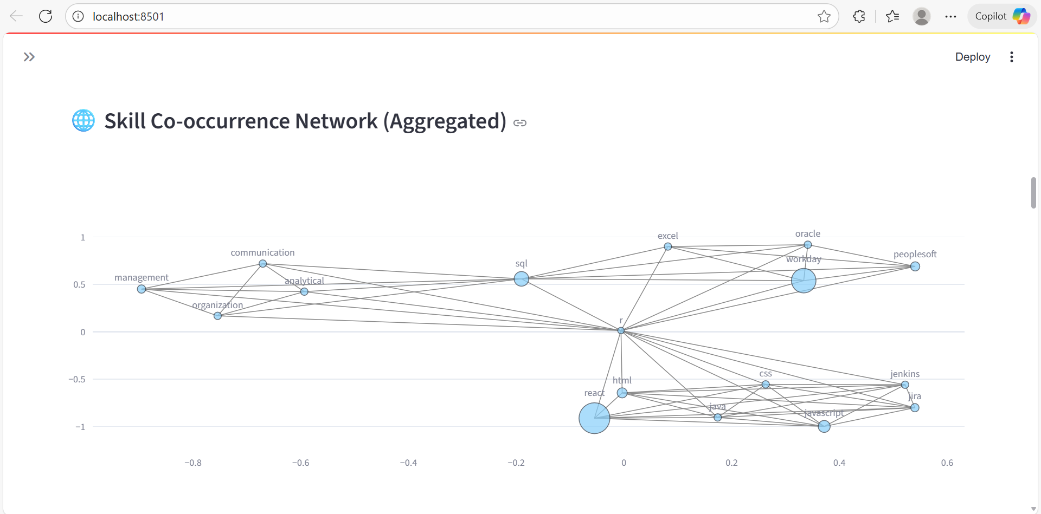
Step3: Resume-level Insights
For each uploaded resume, the app provides detailed analysis including extracted skills, word count, and per-resume word clouds.

Slide 25
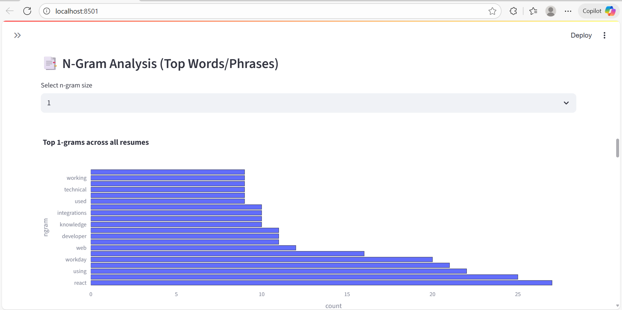
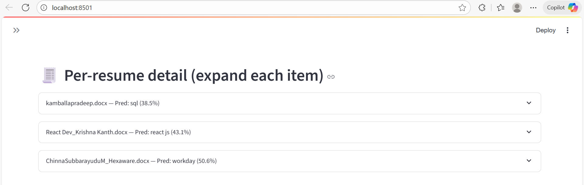

Slide 26
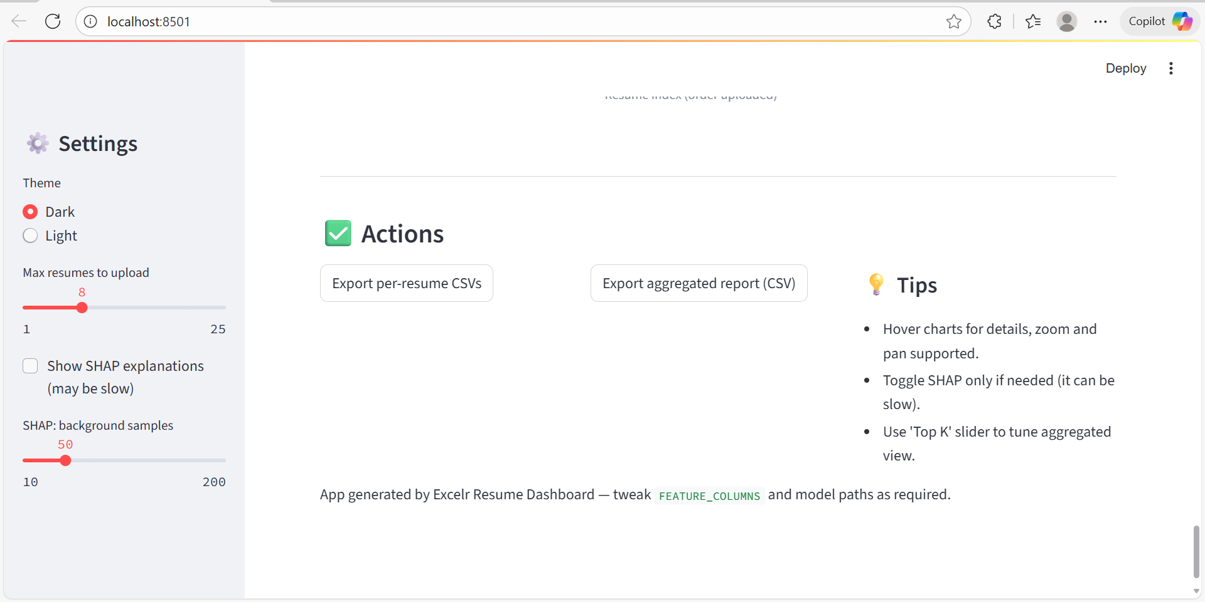
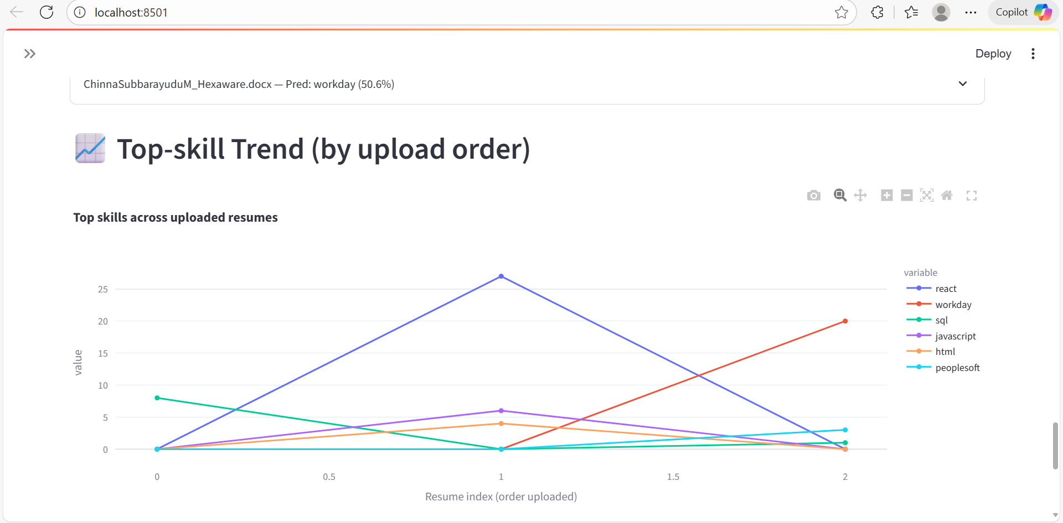
Step 4: Classification Prediction
The backend ML model predicts the job category (React, SQL, Workday, Peoplesoft, Internship) for each resume, showing predicted class and confidence scores.

Slide 27
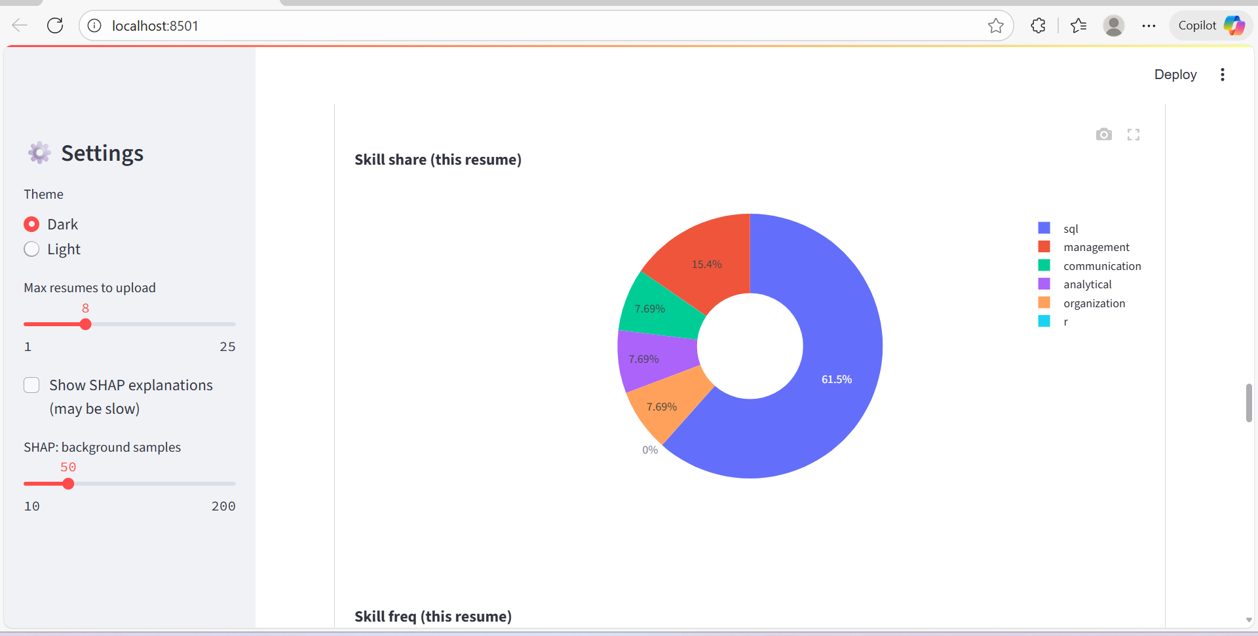
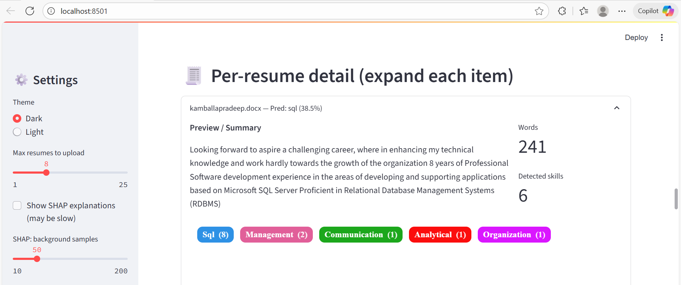
Results & Insight’s
Model Interpretation
SHAP values and explanation plots display the influence of various skills and keywords on the classification results, enhancing model transparency.

Slide 28
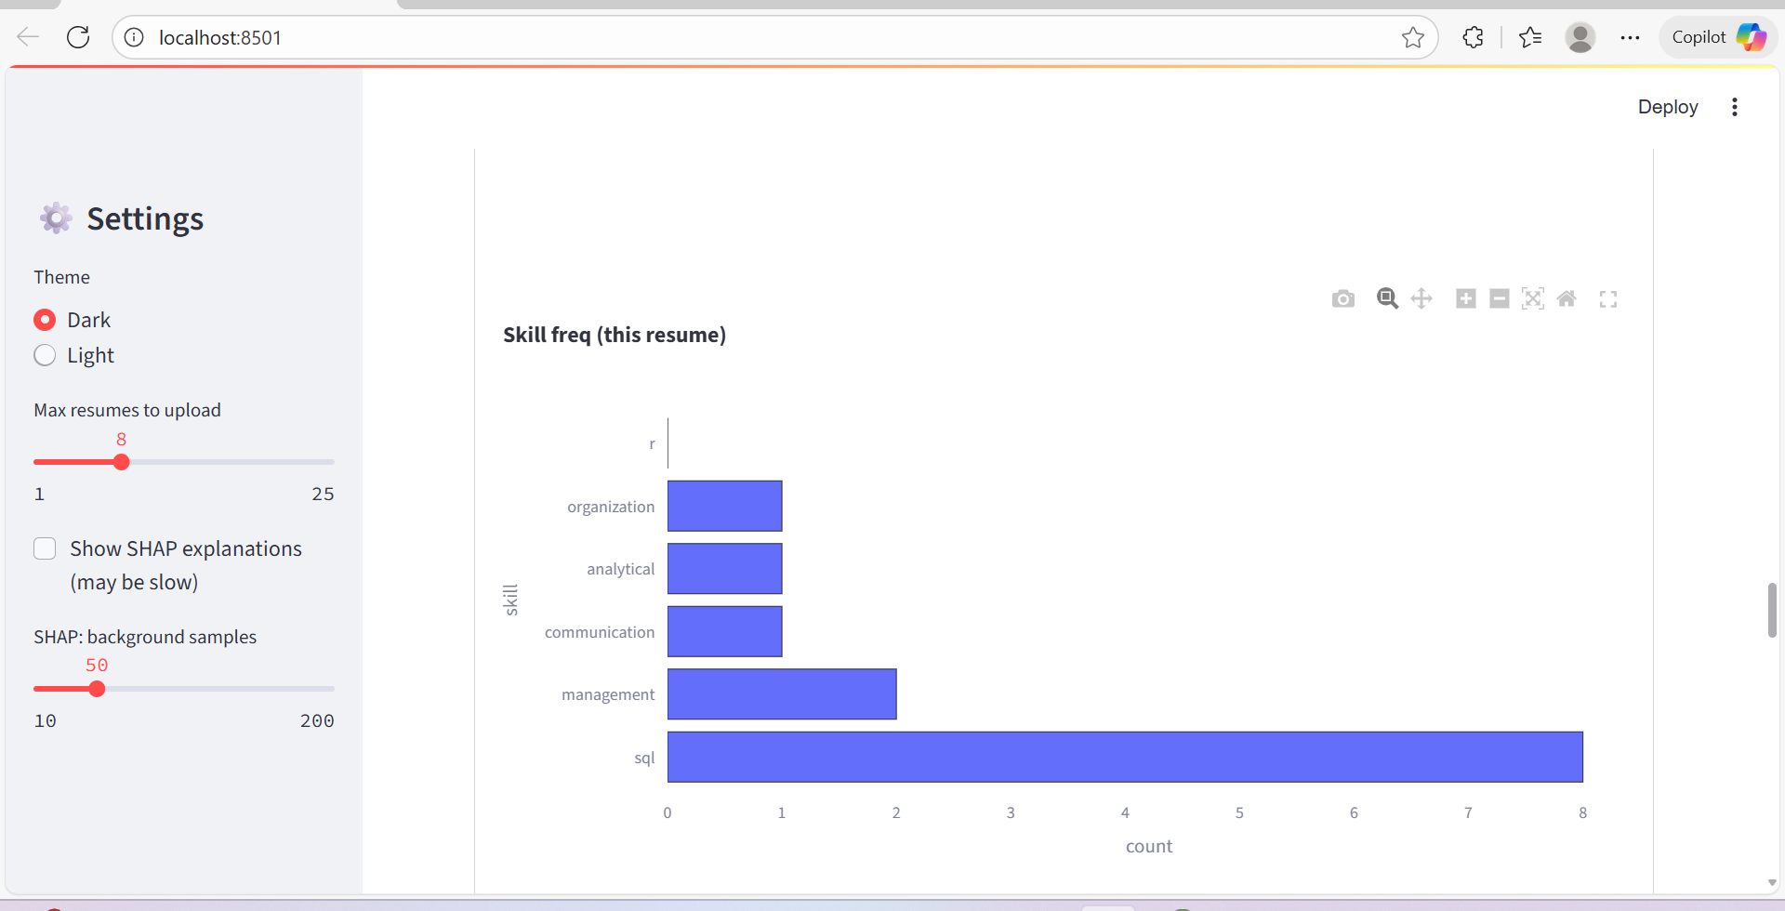
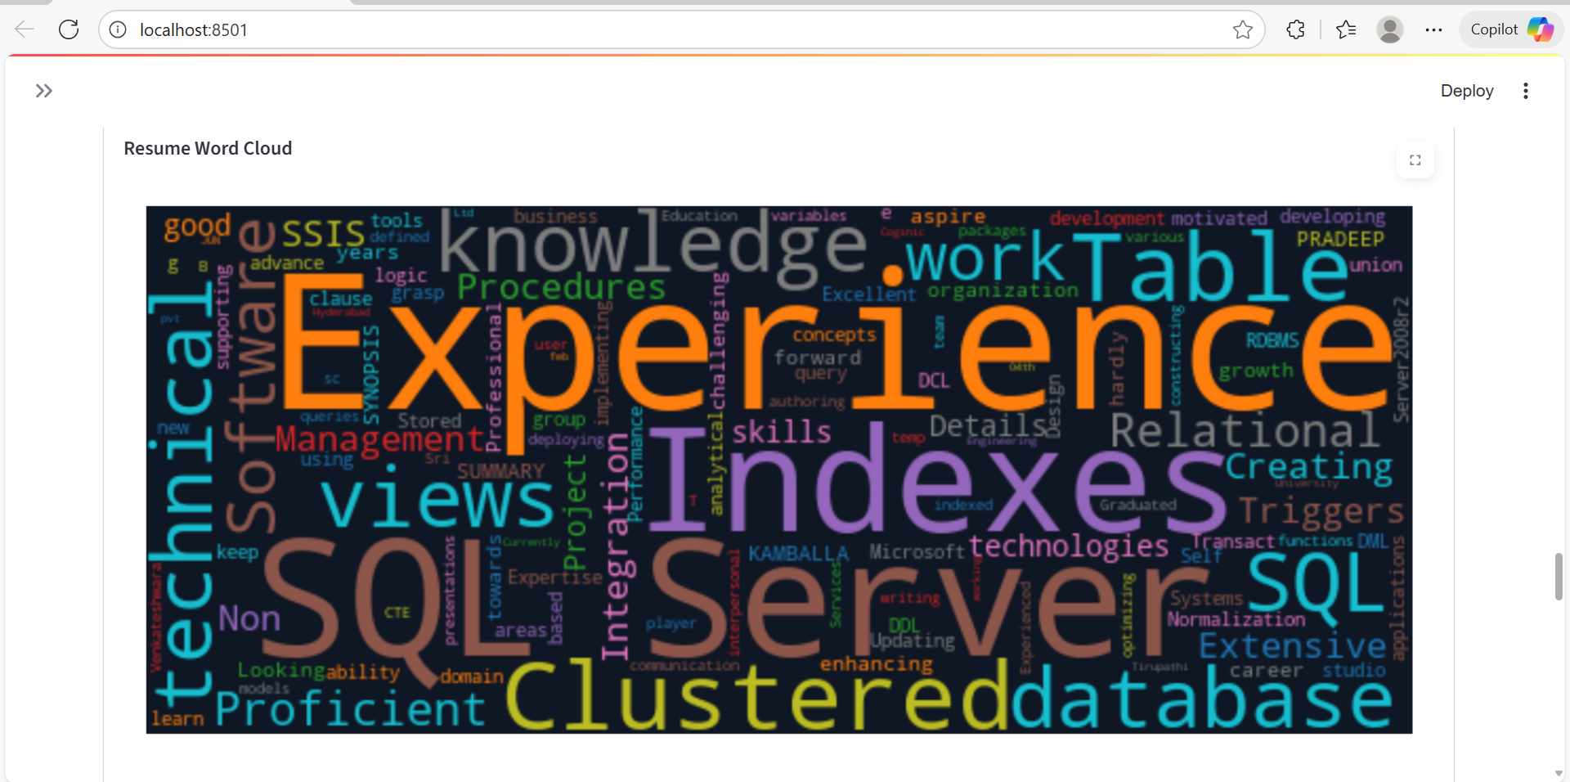

Slide 29
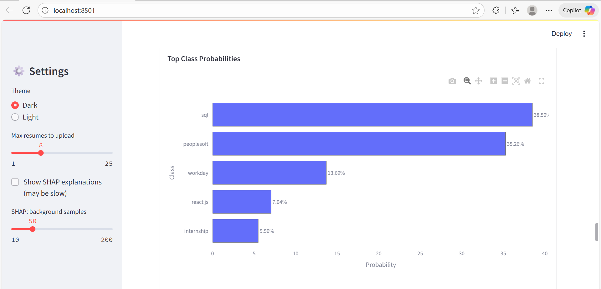

Customization & Export
Users can adjust parameters like the number of displayed skills and download the results for further use or sharing.

Slide 30
Conclusion
Resume classification using ML automates manual screening.
Preprocessing and feature extraction (TF-IDF, CountVectorizer) improved model performance.
Among tested models (Logistic Regression, SVM, Random Forest, XGBoost), the best accuracy was achieved by [insert best model name from results].
WordClouds and confusion matrices confirmed the effectiveness of the approach.
Can significantly reduce recruiter workload and speed up hiring.
Future Work:
Use deep learning models (e.g., BERT, RoBERTa) for better semantic understanding.
Expand dataset with more resume samples across diverse fields.
Deploy as a web or HR tool for real-time classification.

Slide 31
THANK YOU

